Slide 1
Learner Induction
2022-2023 Academic year

Slide 2
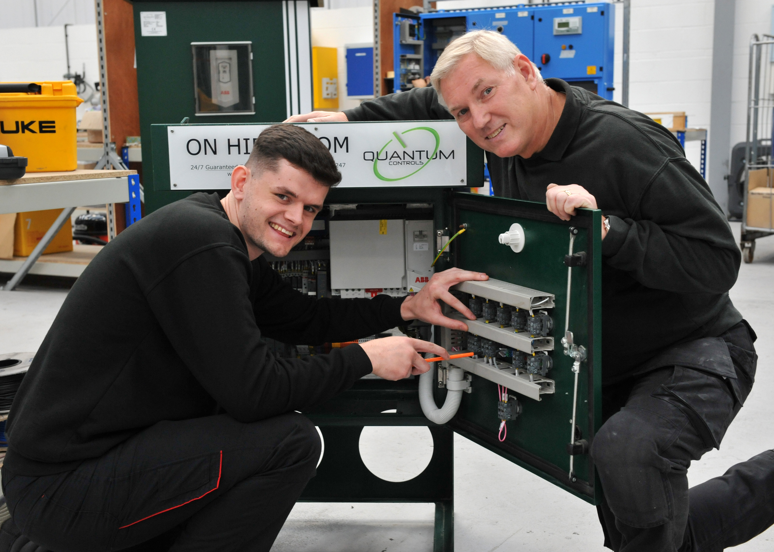
About Us
Your course is funded by South Tyneside Works, a department of South Tyneside Council that delivers government funded post-16 education and training.
If you live in South Tyneside and the surrounding South of Tyne areas, our funding comes from the Education & Skills Funding Agency.
For our learners living in Newcastle, North Tyneside or Northumberland our funding comes from the North of Tyne Combined Authority.
South Tyneside Works directly delivers training and commissions to a number of different training providers for the delivery of a wide range of learning including:
Non-accredited learning, introductory and short courses
Entry Level - Level 3 accredited programmes
Study Programmes
Visit our website for more information:www.southtyneside.gov.uk/southtynesideworks
Notes:
Welcome to South Tyneside Works.
South Tyneside Works is a department of South Tyneside Council that delivers government funded post 16 education and training. It is funded by the Education & Skills Funding Agency and directly delivers training and commissions to a number of different training providers for the delivery of a wide range of learning including:
Non-accredited learning, introductory and short courses
Entry Level - Level 3 accredited programmes
Study Programmes and Traineeships
For more information on the courses we fund visit our website: Need new link here

Slide 3
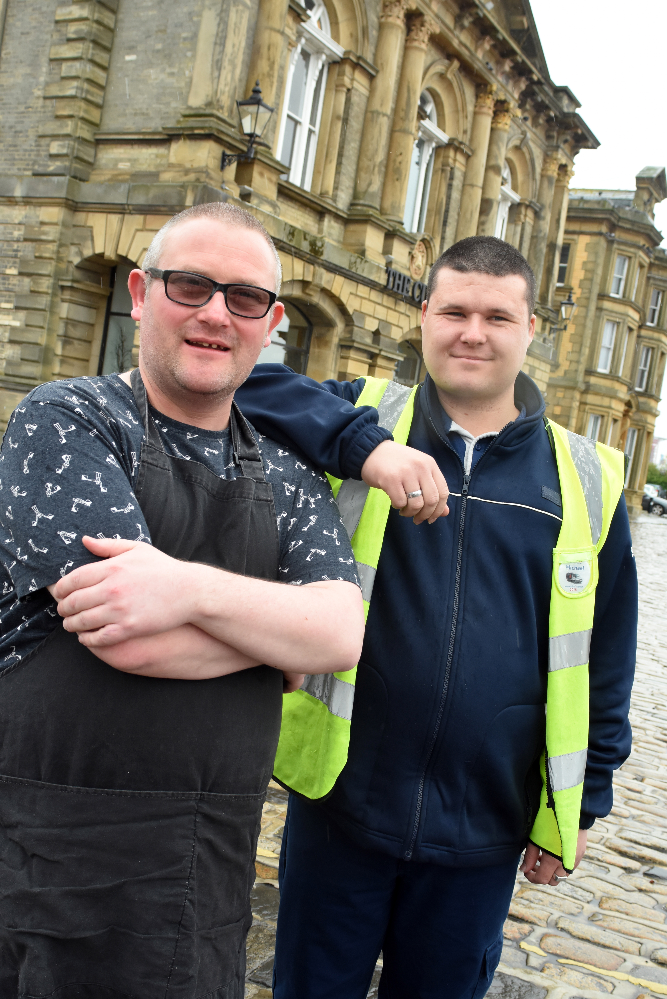
Induction
As part of your induction, we will now cover the following information, using the learner handbooks, which you should all have a copy of.
Attendance
Behaviour and Misconduct
Supporting You as a Learner
Additional Learner Support
Maths and English
Equality and Diversity
Your Safety and Welfare
First Aid and Emergencies
Mental and Physical Health
Safeguarding
Prevent
British Values
Use of the Internet and Social Media
E Safety
Notes:
This induction is a mandatory element of the course and takes approximately 20 minutes. During this induction you should refer to your learner handbook as we cover the following information:
Attendance- You will gain the most from your course if you attend when expected. For most qualifications, there is a minimum attendance expectation in order to achieve the qualification. We understand that sometimes absence is unavoidable, but it is important to communicate this with your tutor or training provider. They may be able to offer advice or support if needed. If you do not attend three session in a row and your tutor cannot get in contact with you, you may be withdrawn from your course so please stay in touch.
Behaviour and Misconduct- Behaviour that is considered as misconduct may result in disciplinary action. For example: Not following Health and Safety regulations, behaviour that disrupts teaching and learning, behaviour or language which is racially, sexually or generally offensive and or discriminatory to others, causing damage to equipment, buildings or resources, violence or threats of violence, interfering with software or misusing technology including inappropriate use of social media. Repeated misconduct or a serious violation may result in your being asked to leave the course.
Supporting You as a Learner South Tyneside Works are committed to making learning accessible to everyone. Learner support may be available to help you achieve and complete your course to the best of your ability. If you meet the eligibility criteria you could access support workers in the classroom, books or specialist equipment.
Additional Learner Support If you do think we could help you with something, please speak to your tutor.
Maths and English are essential to everyday life and employment. Your tutor will help you develop these during your course and improve your maths and English skills. They will do this alongside the learning goals of your course. Maths and English skills help improve your chances when looking or progressing into work, access further training and managing your own finances. Please speak to your tutor or visit our website if you are interested in improving your maths and English skills.
Equality and Diversity Skills South Tyneside are committed to equal opportunities for all, and everyone has the right to access education and work in environments free of discrimination no matter what age, race, disability, religion or sexual orientation. Diversity is valued and we aim to promote equal opportunities. There is a zero tolerance of all forms of discrimination, bullying and harassment.
Your Safety and Welfare- We will ensure a safe and healthy environment for all our learners and staff. You as learners also have a duty of care to take reasonability for your health and safety, taking into consideration the safety of others also. If you do have any existing health condition, please make sure you have informed your tutor of this.
First Aid and Emergencies Your tutor in your training provider will show you where the first aid box is situated, explain their fire safety procedures and drills, notify you of risk assessments untaken and how you should report an accident.
Use of the Internet and Social Media
E Safety
Mental and Physical Health We want to ensure learners understand how to look after their mental and physical health by being active, sleeping well, eating healthy, staying safe and keep learning. We are here if you need us to listen and we will talk to anyone who wants or needs support. You can also call our freephone number, email or contact other organizations that our listed in your learner handbook.
Safeguarding
Prevent
British Values

Slide 4
What is Safeguarding?
Safeguarding is about protecting vulnerable adults and children from the following abuse and neglect
Domestic abuse  Physical abuse  Psychological and emotional abuse  Sexual abuse  Financial or material abuse  Mate crime  Hate crime  Discriminatory abuse  Modern slavery  Self-neglect  Hoarding  Organisational abuse  Neglect or acts of omission
What is Prevent?
The Prevent Duty was brought in under section 26 of the Counter-Terrorism to prevent people from being drawn into terrorism.’ It aims to keep people and communities safe from the threat of terrorism by stopping people becoming radicalised or supporting terrorism.
.
What are British Values?
Democracy  The rule of law  Individual liberty  Mutual respect and tolerance for those of different faiths and beliefs.
All learners must respect other people and support British values in their interactions with staff and learners.
Notes:
You have a right to feel safe when you learn. We are committed to providing a safe and secure environment when learning. READ SLIDE INFO. If you experience or witness anything that makes you feel uncomfortable, uneasy, threatened, intimidated, bullied or unhappy then please speak to your tutor or the additional contacts in your learner handbook. All information we receive will be treated with respect and confidence. If your tutor feels what you have reported puts you or other at harm or risk, they legally have a duty of care to report this.
READ SLIDE INFO- We want all learners to feel able to discuss/report their concerns.
READ SLIDE INFO

Slide 5
What is E-safety?
E- safety is the safe and responsible use of technology including social media, emailing, texting and gaming.
Throughout your course you will be asked to use technology when:
Completing your enrolment documents
Accessing E-Learning platforms
Carrying out assigned work as part of your course
Updating your employment documents and/or applying for work
We all have a responsibility to ensure we use it in a way that is safe and respectful to protect yourself and others.
Unacceptable use may result in access privileges being withdrawn, disciplinary action and or/appropriate legal action.
Communication made in a personal capacity through social media should not be unlawful or contain anything discriminatory against, or bullying or harassment against any individual.
Notes:
If you are concerned about anything you have seen online or messages you have received; please speak to your tutor.

Slide 6
What Next?
Study Programme
If you’re aged 16-18, a Study programme will help you gain the skills and qualifications you need to progress within your chosen vocational area, including maths, English and ICT.
Traineeships
If you’re aged 16-24, a traineeship is a programme that will help you gain work experience - getting you ready for work or an apprenticeship.
Apprenticeships
Improve your skills and knowledge whilst gaining a qualification through ‘on the job’
training. Apprenticeships cover a wide range of industries. We can help you to find the
apprenticeship that is right for you.
Adult Vocational Pathways
Do you need to develop or improve your skills? We offer employment &
vocational programmes across various sectors & levels including Functional
Skills and qualifications within key sectors including Engineering, Technology,
Retail and ICT.
Notes:
South Tyneside Works offer a wide range of programmes to support you to reach your full potential. Once you have completed your current course your tutor will support you to plan your next steps and discuss the options available to help you to reach your goal. If you would like further information about what your next steps would be you can contact us or your training provider. You’ll find our details in your learner handbook.

Slide 7
South Tyneside Works Social Media platforms
Make sure to like and follow us on:
Facebook
https://www.facebook.com/STynesideWorks/
Twitter
www.twitter.com/STyneWorks
Instagram
www.instagram.com/SouthTynesideWorks
LinkedIn
www.linkedin.com/company/SouthTynesideWorks
These often share useful careers information, details about free courses and even job vacancies
Notes:
You can access additional help and support from South Tyneside works through our facebook, , Twitter and Instagram pages where we share information on careers, details of free courses and current vacancies in the borough.

Slide 8
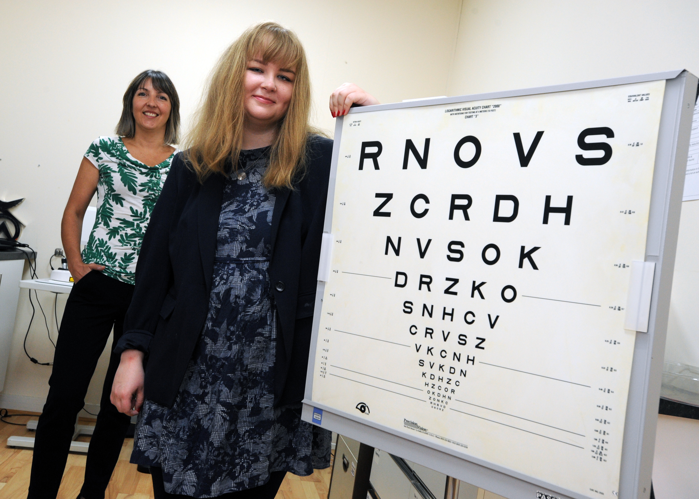
Whether it’s your first steps into employment, a change in career or a return to work after a break, our courses ensure you’re prepared when facing an employer at interview and in your first days at work.
South Tyneside has job roles across various sectors with employers you’ll be familiar with such as NHS, Port of Tyne and Barbour as well as industry leading companies such as Katy Sue Designs, Metec UK and Nine Software.
We’ll support you to explore your options and ensure you’ve the skills needed to access the variety of roles on offer and around South Tyneside.
Previous learners have gone on the gain employment with Nissan, Tesco, Quantum Controls, Haven Holidays, Subway and HMRC just to name a few.
Others have gone on to set up their own business.

Slide 9
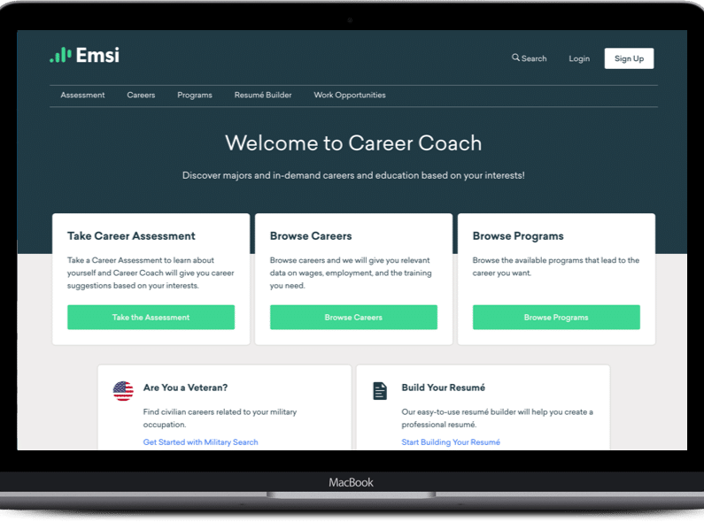
Career Coach is a interactive online tool where you can take an interactive career assessment, browse careers, courses and even use the CV builder – try it out, it’s free!
Southtyneside.emsicc.com
Notes:
You can also access our free interactive online Career Coach tool to carry out an assessment of your skills, browse career options linked to those skills and investigate courses to help you to develop those skills further; there is even a CV builder you can use to help you to create or improve your CV. You can access Career Coach at new link needed here

Slide 10
South Tyneside Residents Newsletter
Case Studies
Your course tutor, or training provider may submit a case study, for learners who have exceeded expectations and gained success following completion of their course.
Could you be the next learner
to feature in our
resident's newsletter?

Slide 11
When will we contact you?
Destination and Progression Information
We will contact you to find out how the course has helped you to progress and work towards your long-term goals.
You can use your enrolment forms to tell us the best way to contact you.
Learner Surveys
You have the opportunity to give feedback:
How are we doing?
Are you unhappy with anything on your course?
How can we make the service better?
What other courses are you interested in?
We may also contact you
following completion of your
course to invite you to fill
in surveys.
Notes:
South Tyneside Works will contact you to find out where you progress to after your course and will use a variety of different methods such as text, phone call or email to collect the information. We encourage you to give open and honest feedback about your experiences.

Slide 12
South Tyneside Works Town Hall and Civic Offices Westoe Road, South Shields, NE33 2RL Call our Freephone number: 0800 073 1772 Email us at: skills.learnerenquiries@southtyneside.gov.uk
Compliments, Complaints and Suggestions
You will have the opportunity to give feedback:
During your course via Evaluation Forms and Learner Forums
Or
At any time via Learner Voice and/or by contacting us at:

